Slide 1
Shared Preferences & Database
Flutter Course

Slide 2
Shared Preferences

Slide 3

Abstract

Slide 4
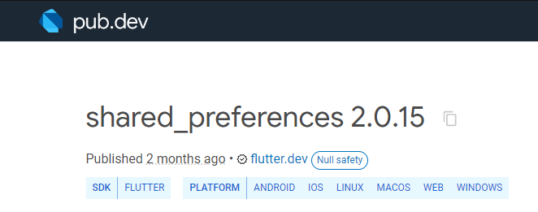
library
shared_preferences: ^2.0.15

Slide 5
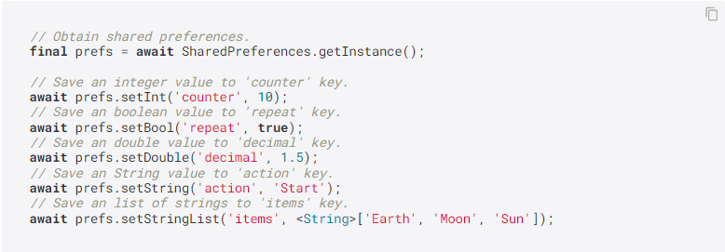
Add Values

Slide 6
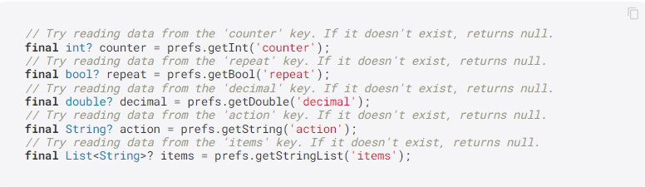
Get Values

Slide 7

Remove Values

Slide 8

Add Values As Map

Slide 9
Breck

Slide 10
Database

